Slide 1
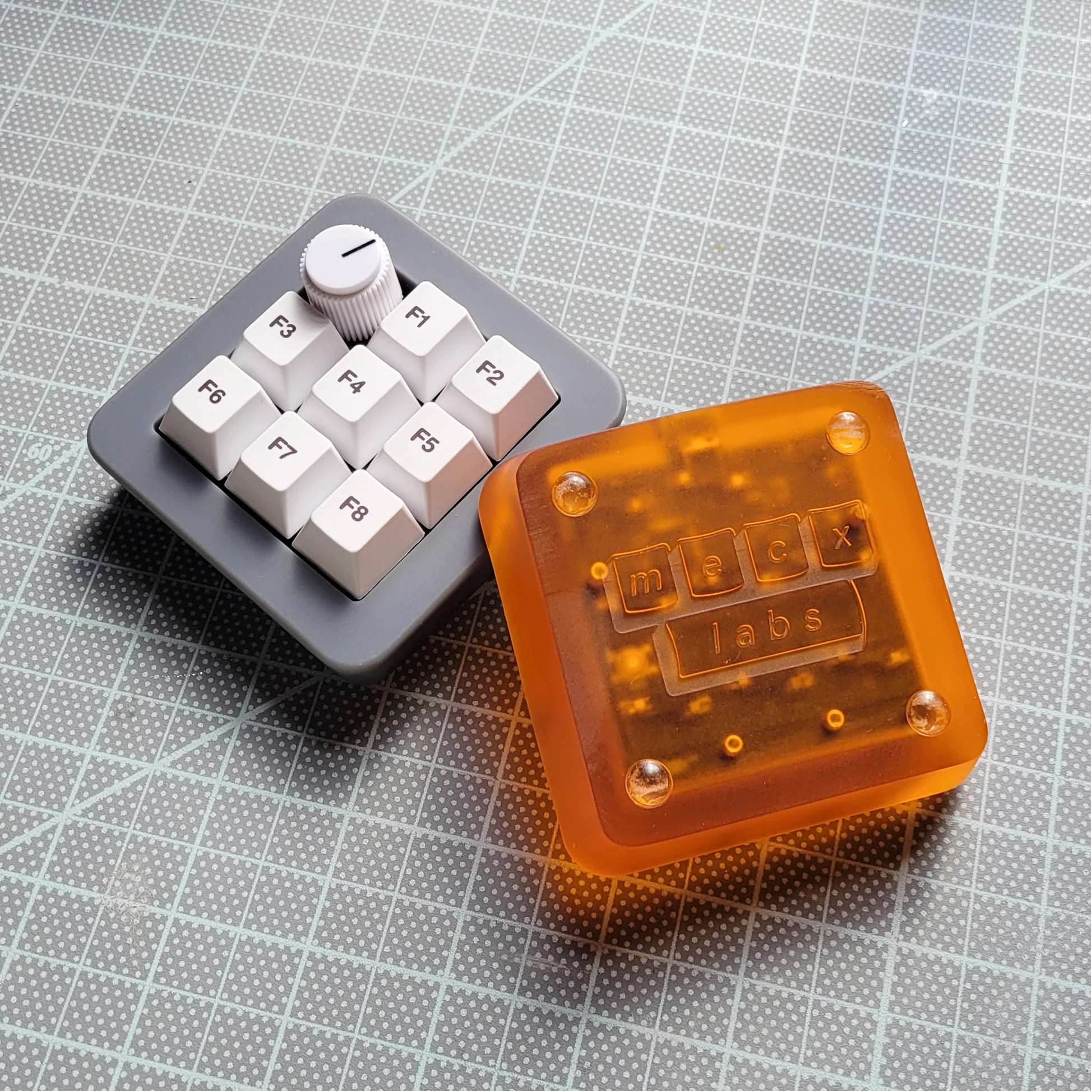
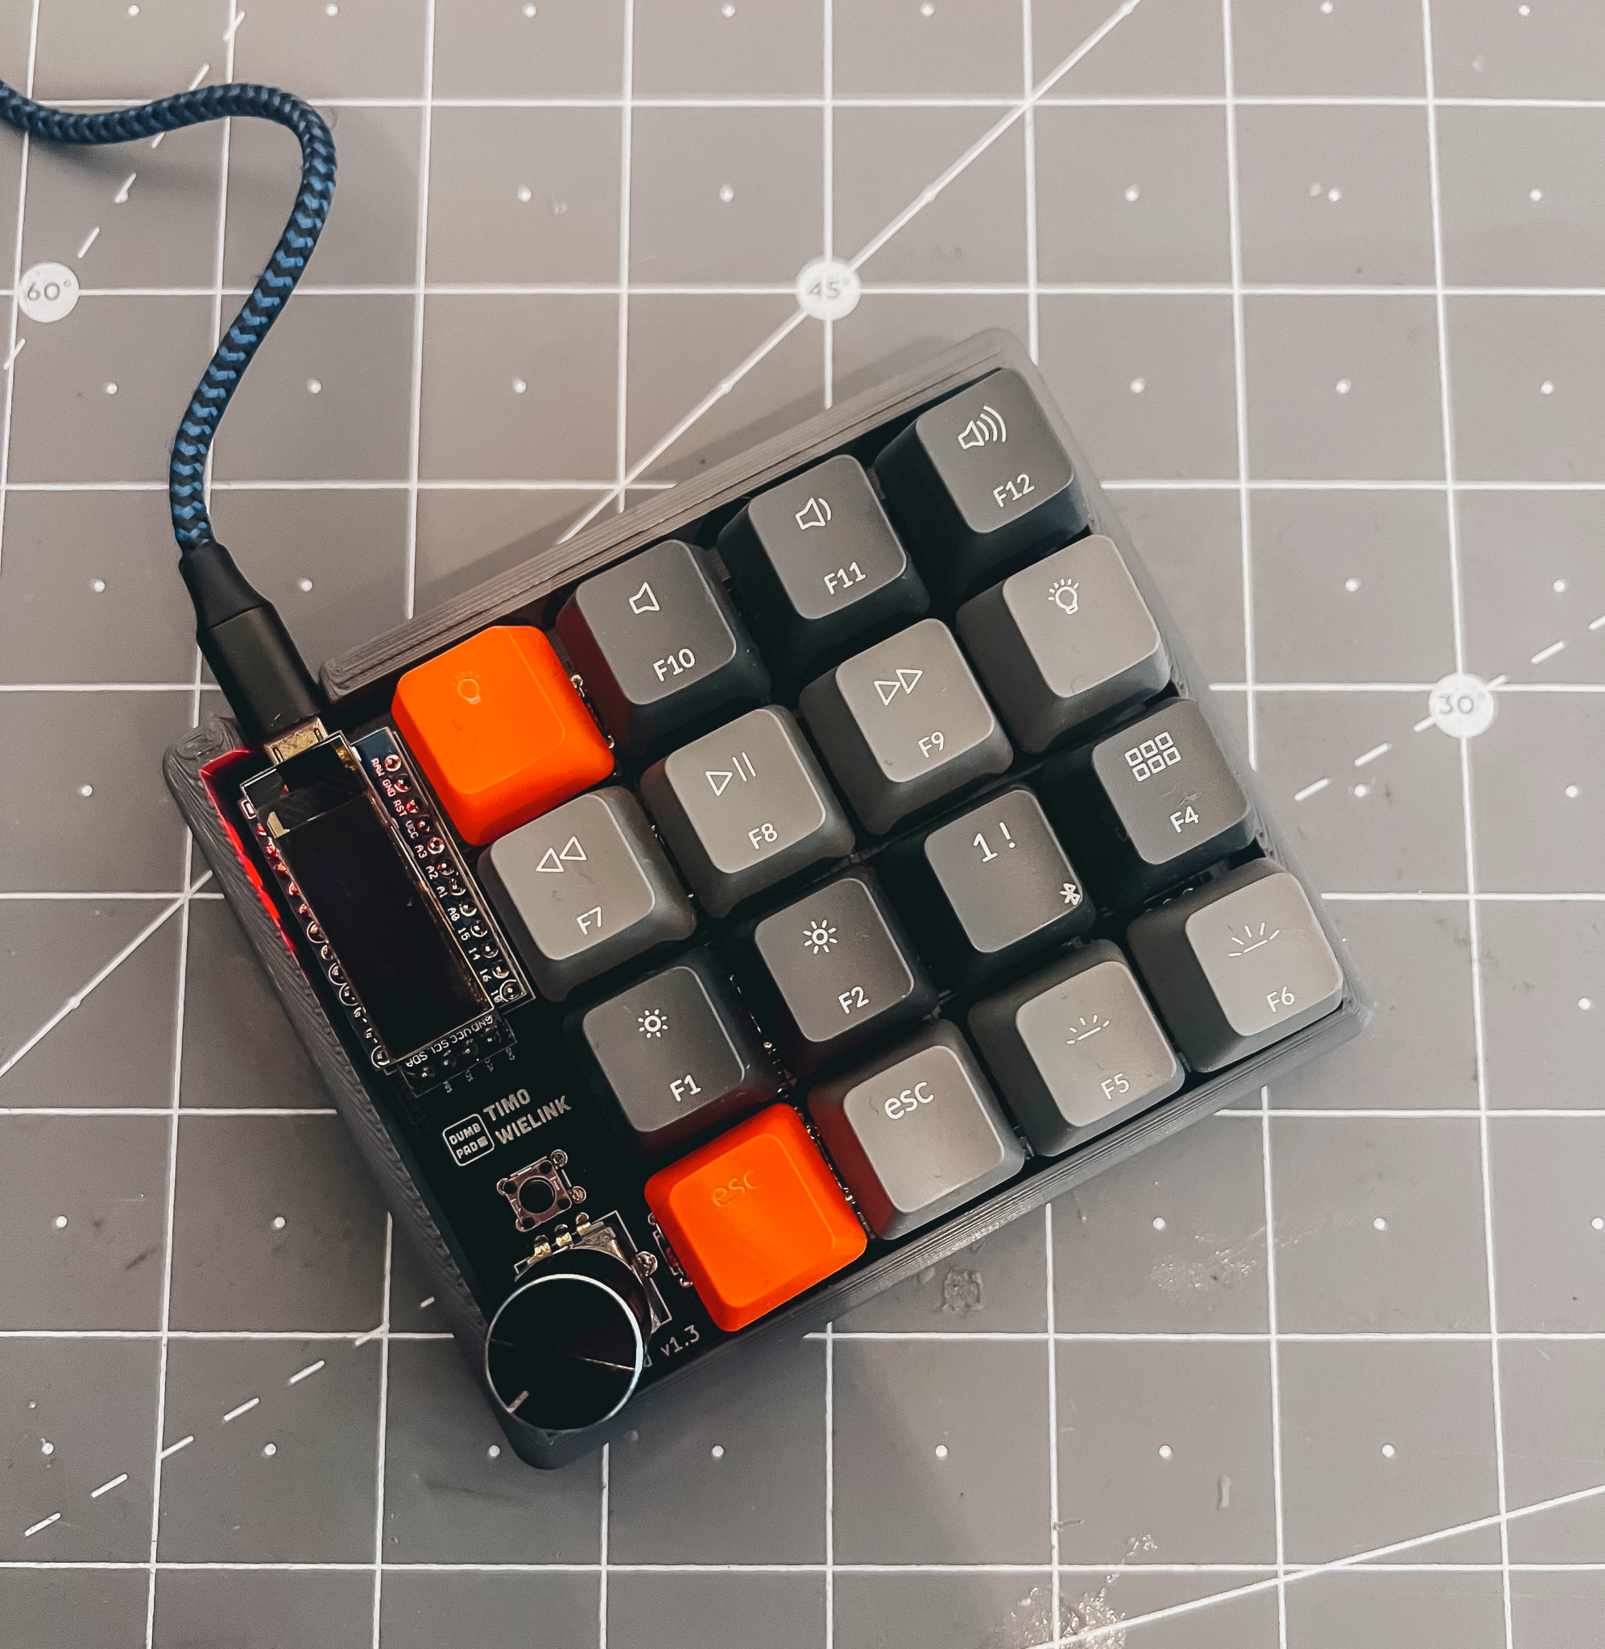
BUILD
Your Own MacroPad!

Slide 2
What is a MacroPad?
A macropad is a small keyboard that provides extra keys to supplement your main keyboard. They're handy for programming things on them like media controls, shortcuts, and macros. They can also be great for gaming as well.

Slide 3
LETS GET STARTED!
We’re going to try and make sure everyone proceeds at the same pace
We only have limited screwdrivers so caring is sharing!
If you need help at any time just let us know!
Most importantly, have fun!
PS - Just Call Me Over for Your Deposit

Slide 4
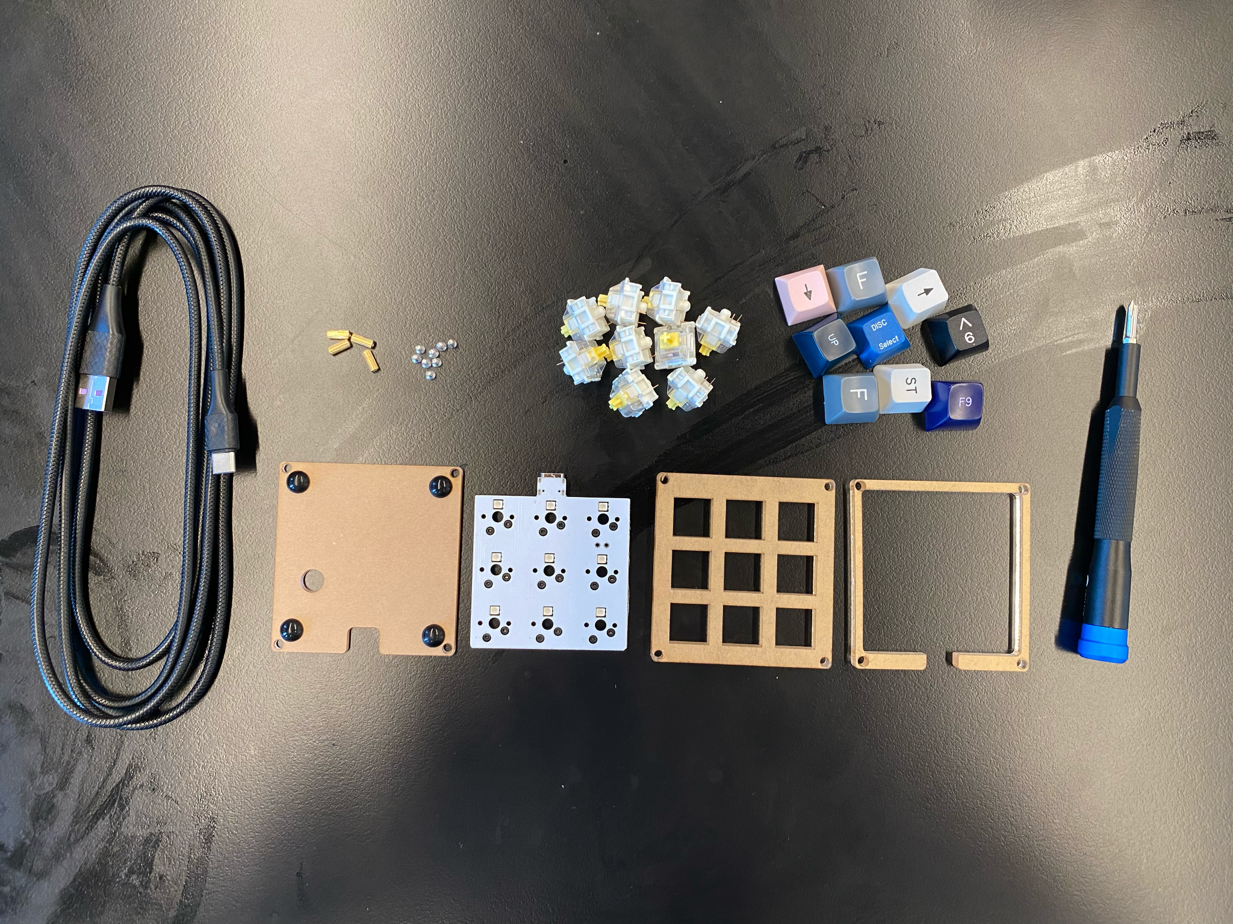

Slide 5
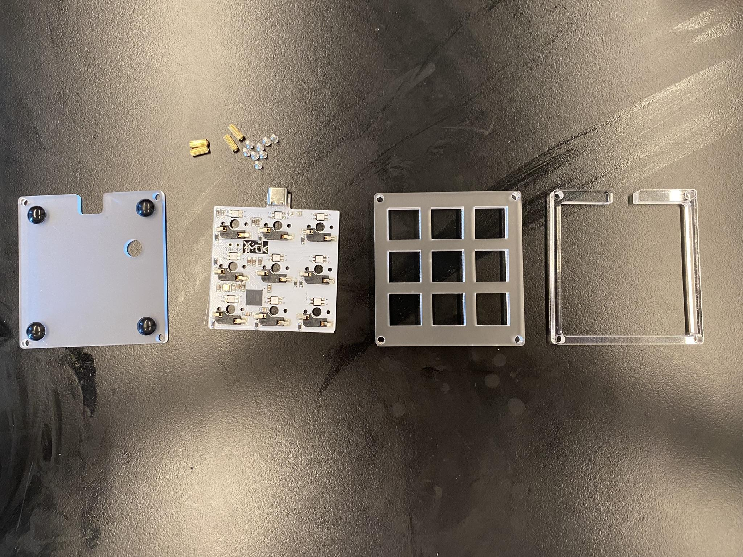

Slide 6
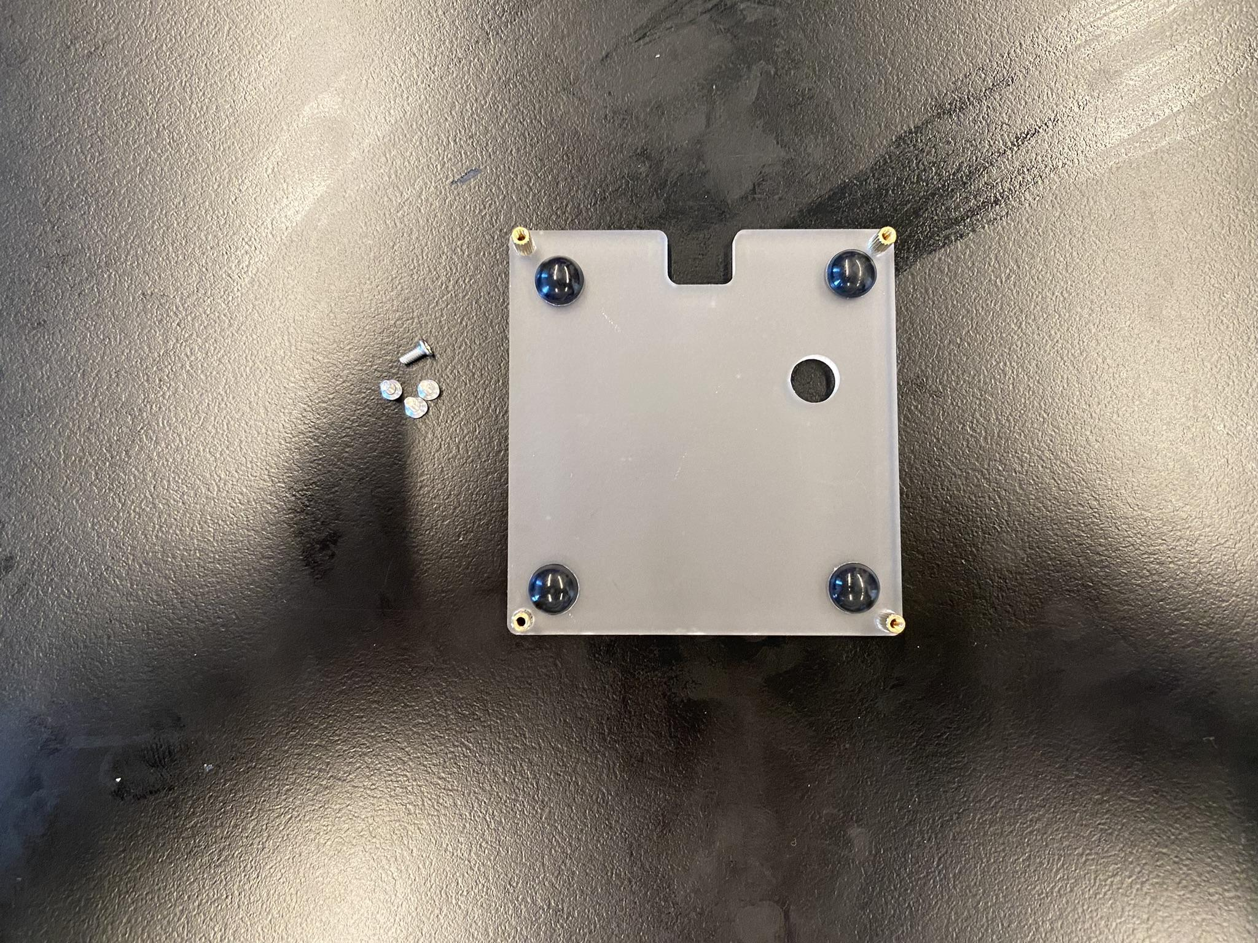

Slide 7


Slide 8
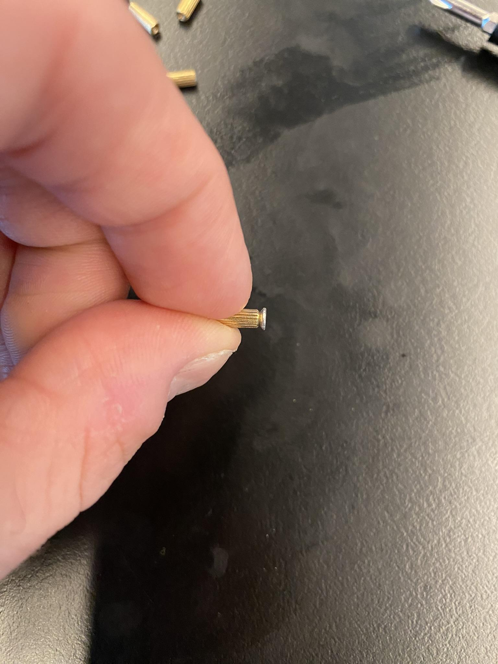

Slide 9


Slide 10
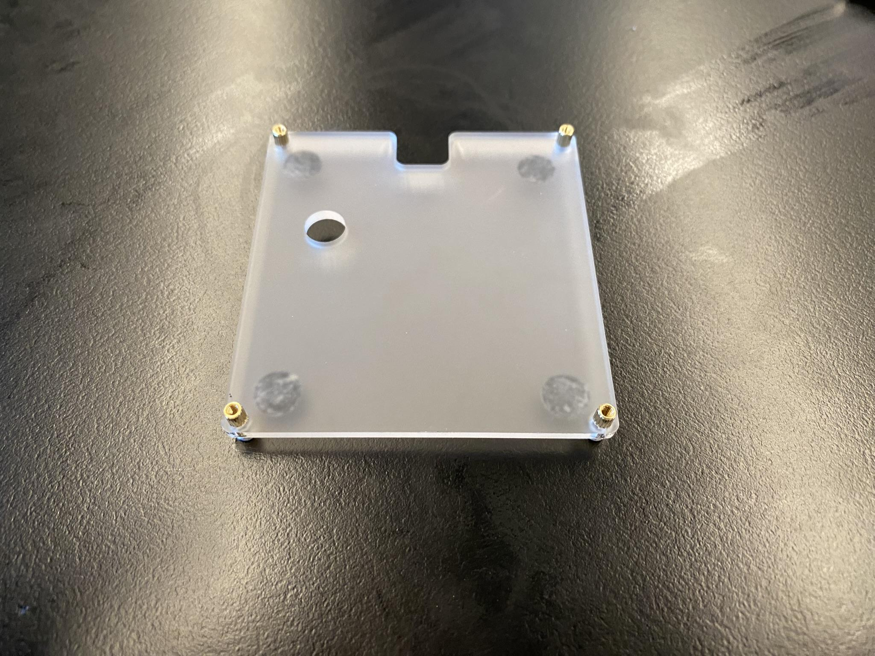

Slide 11
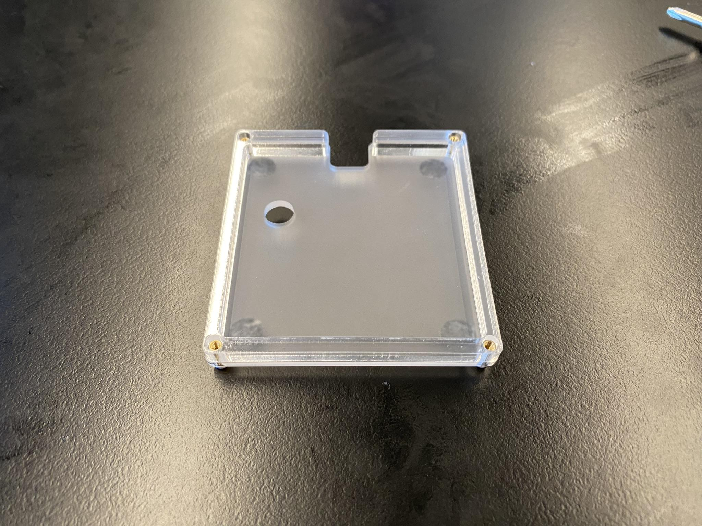

Slide 12
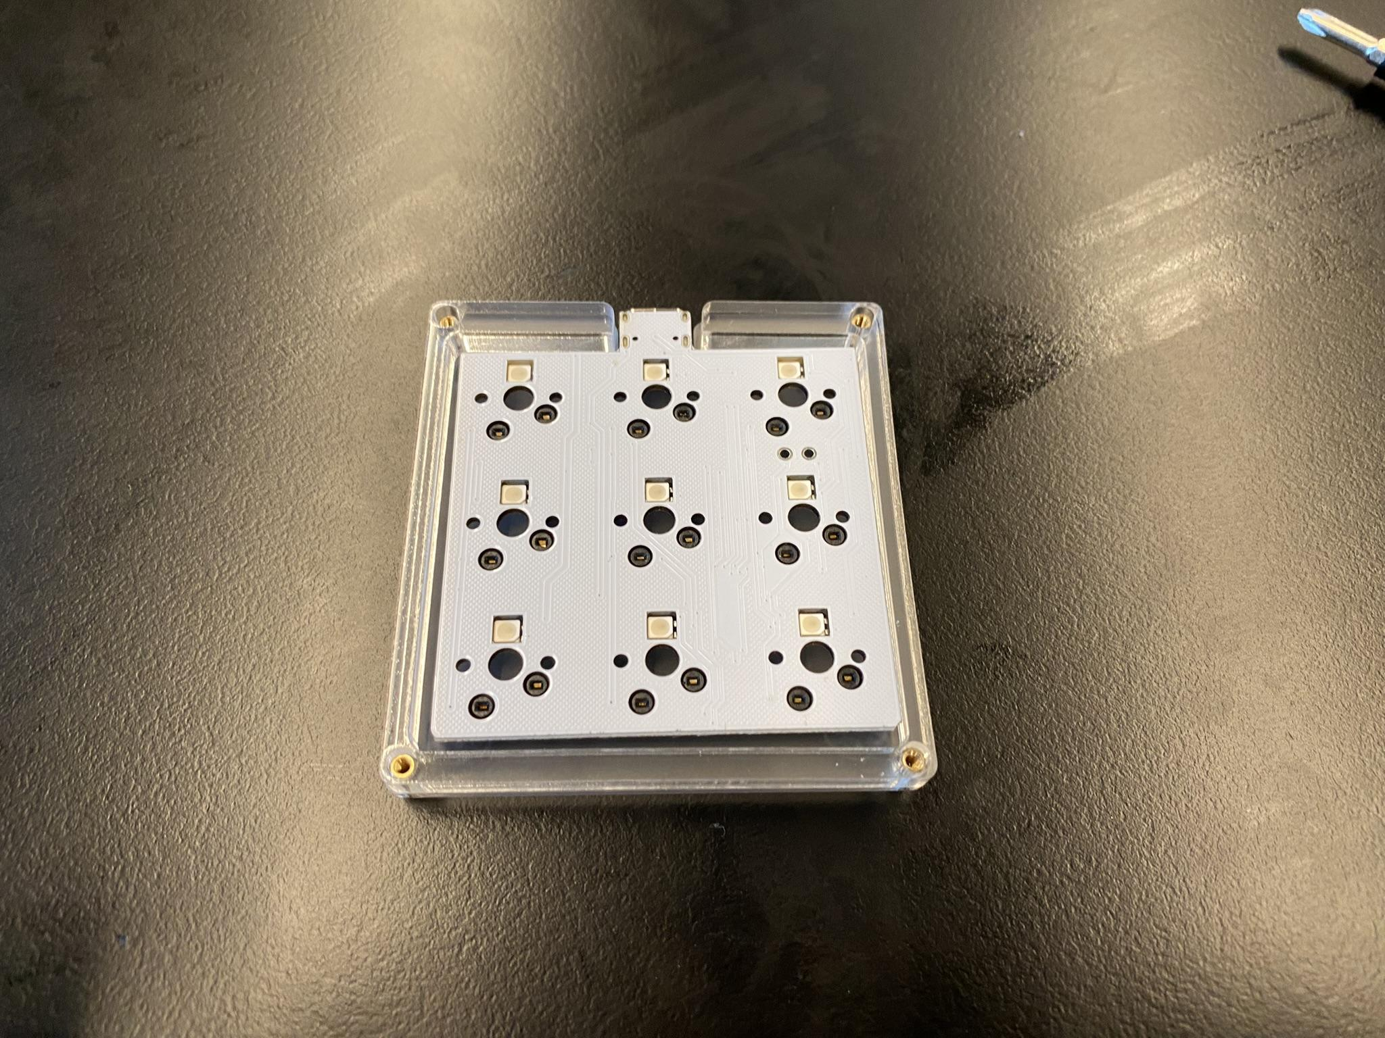

Slide 13
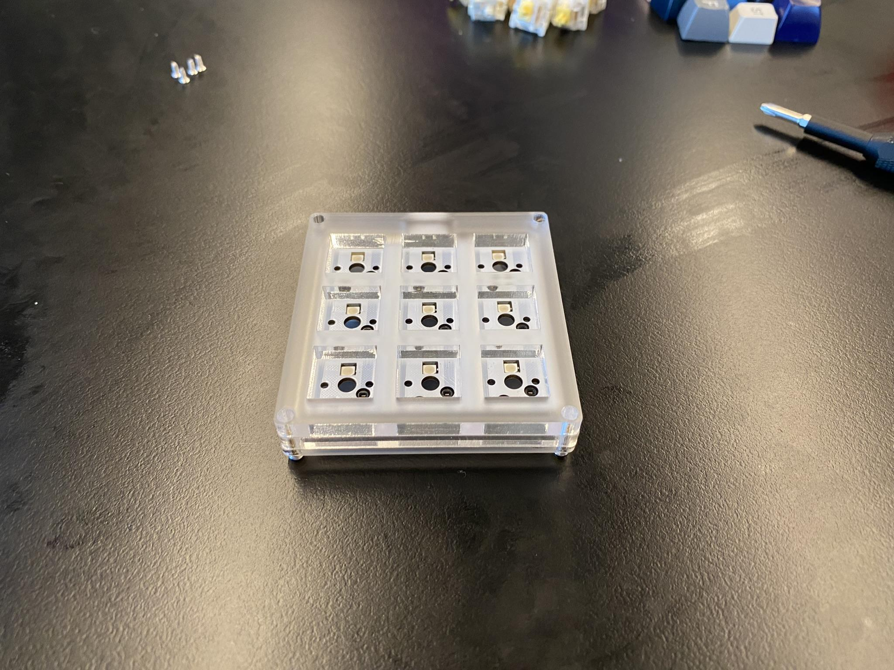

Slide 14
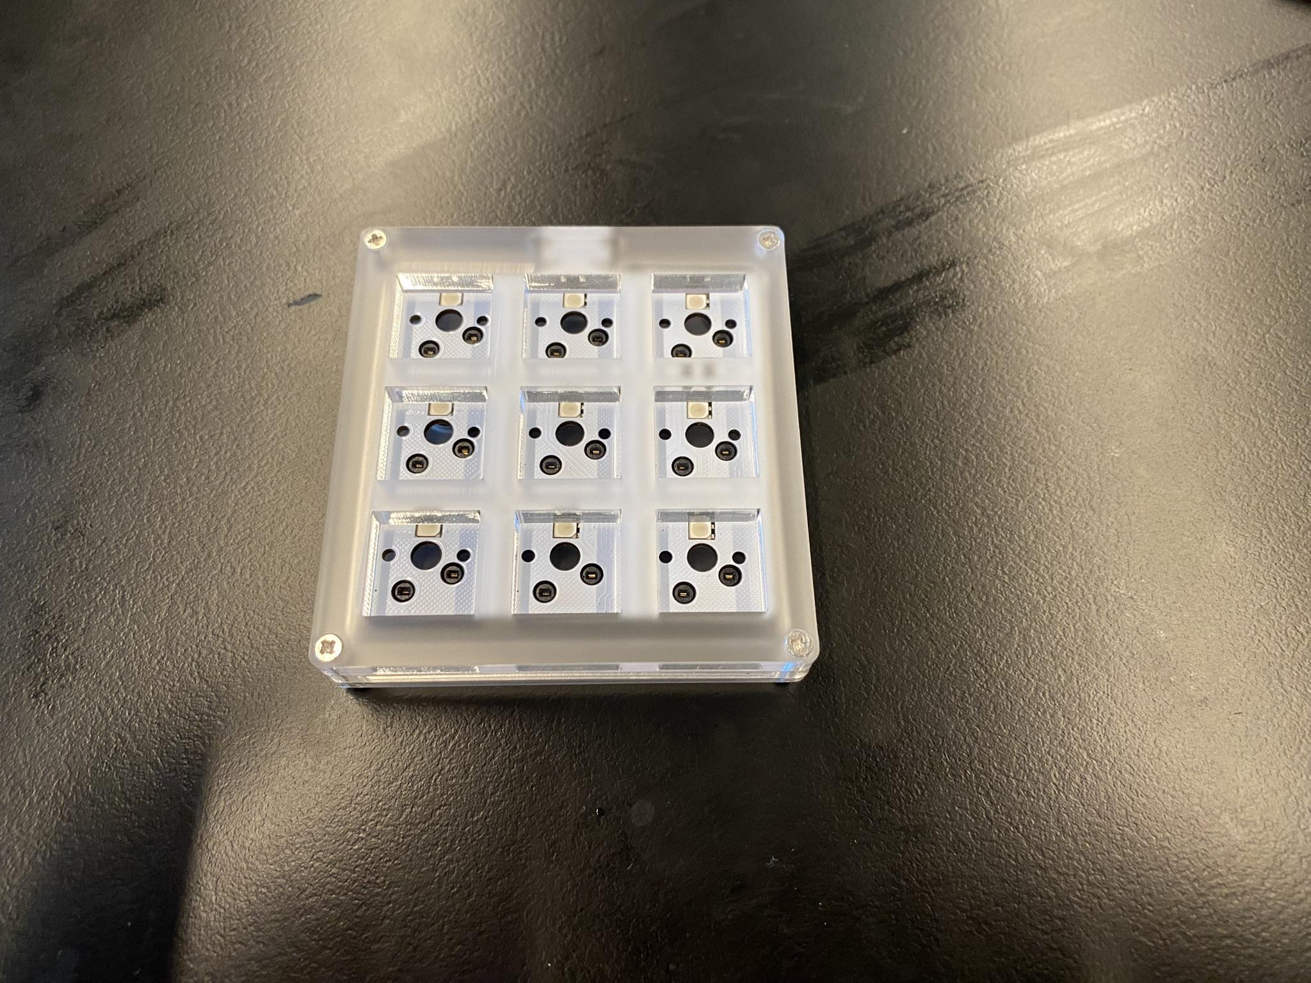

Slide 15
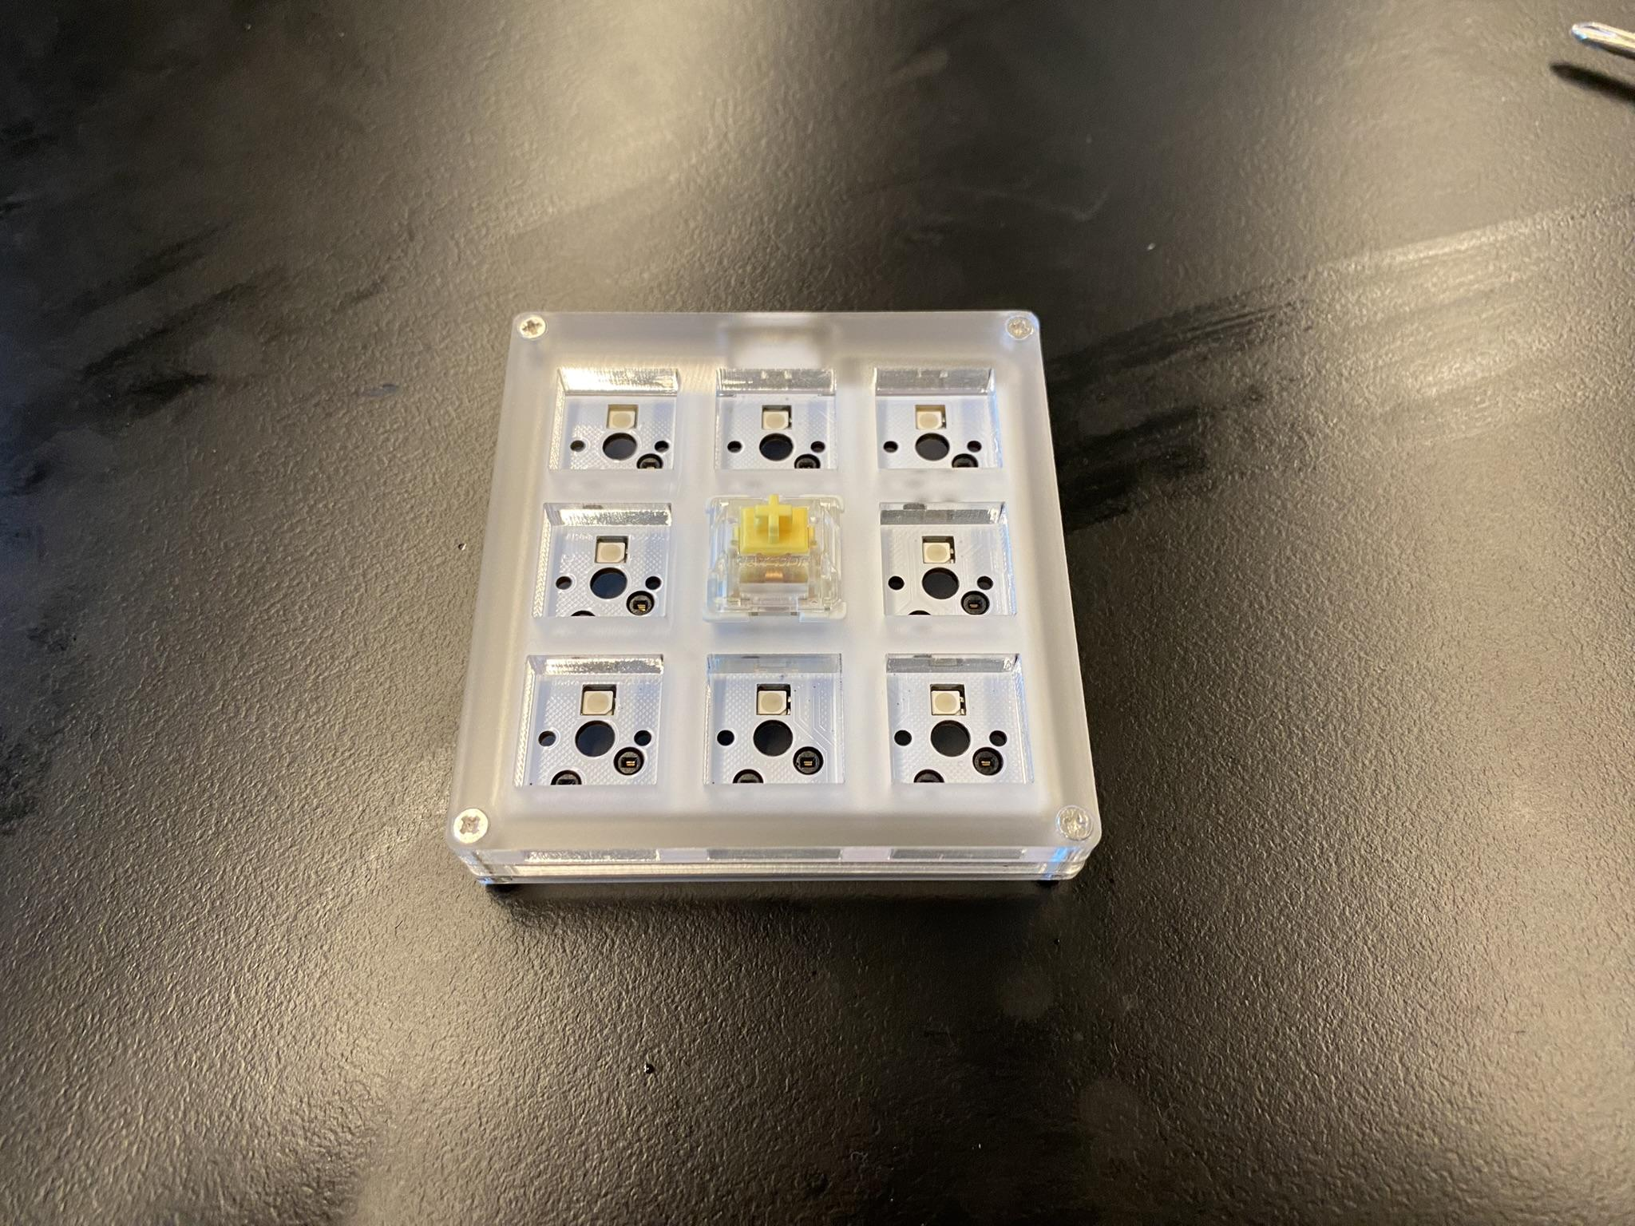

Slide 16
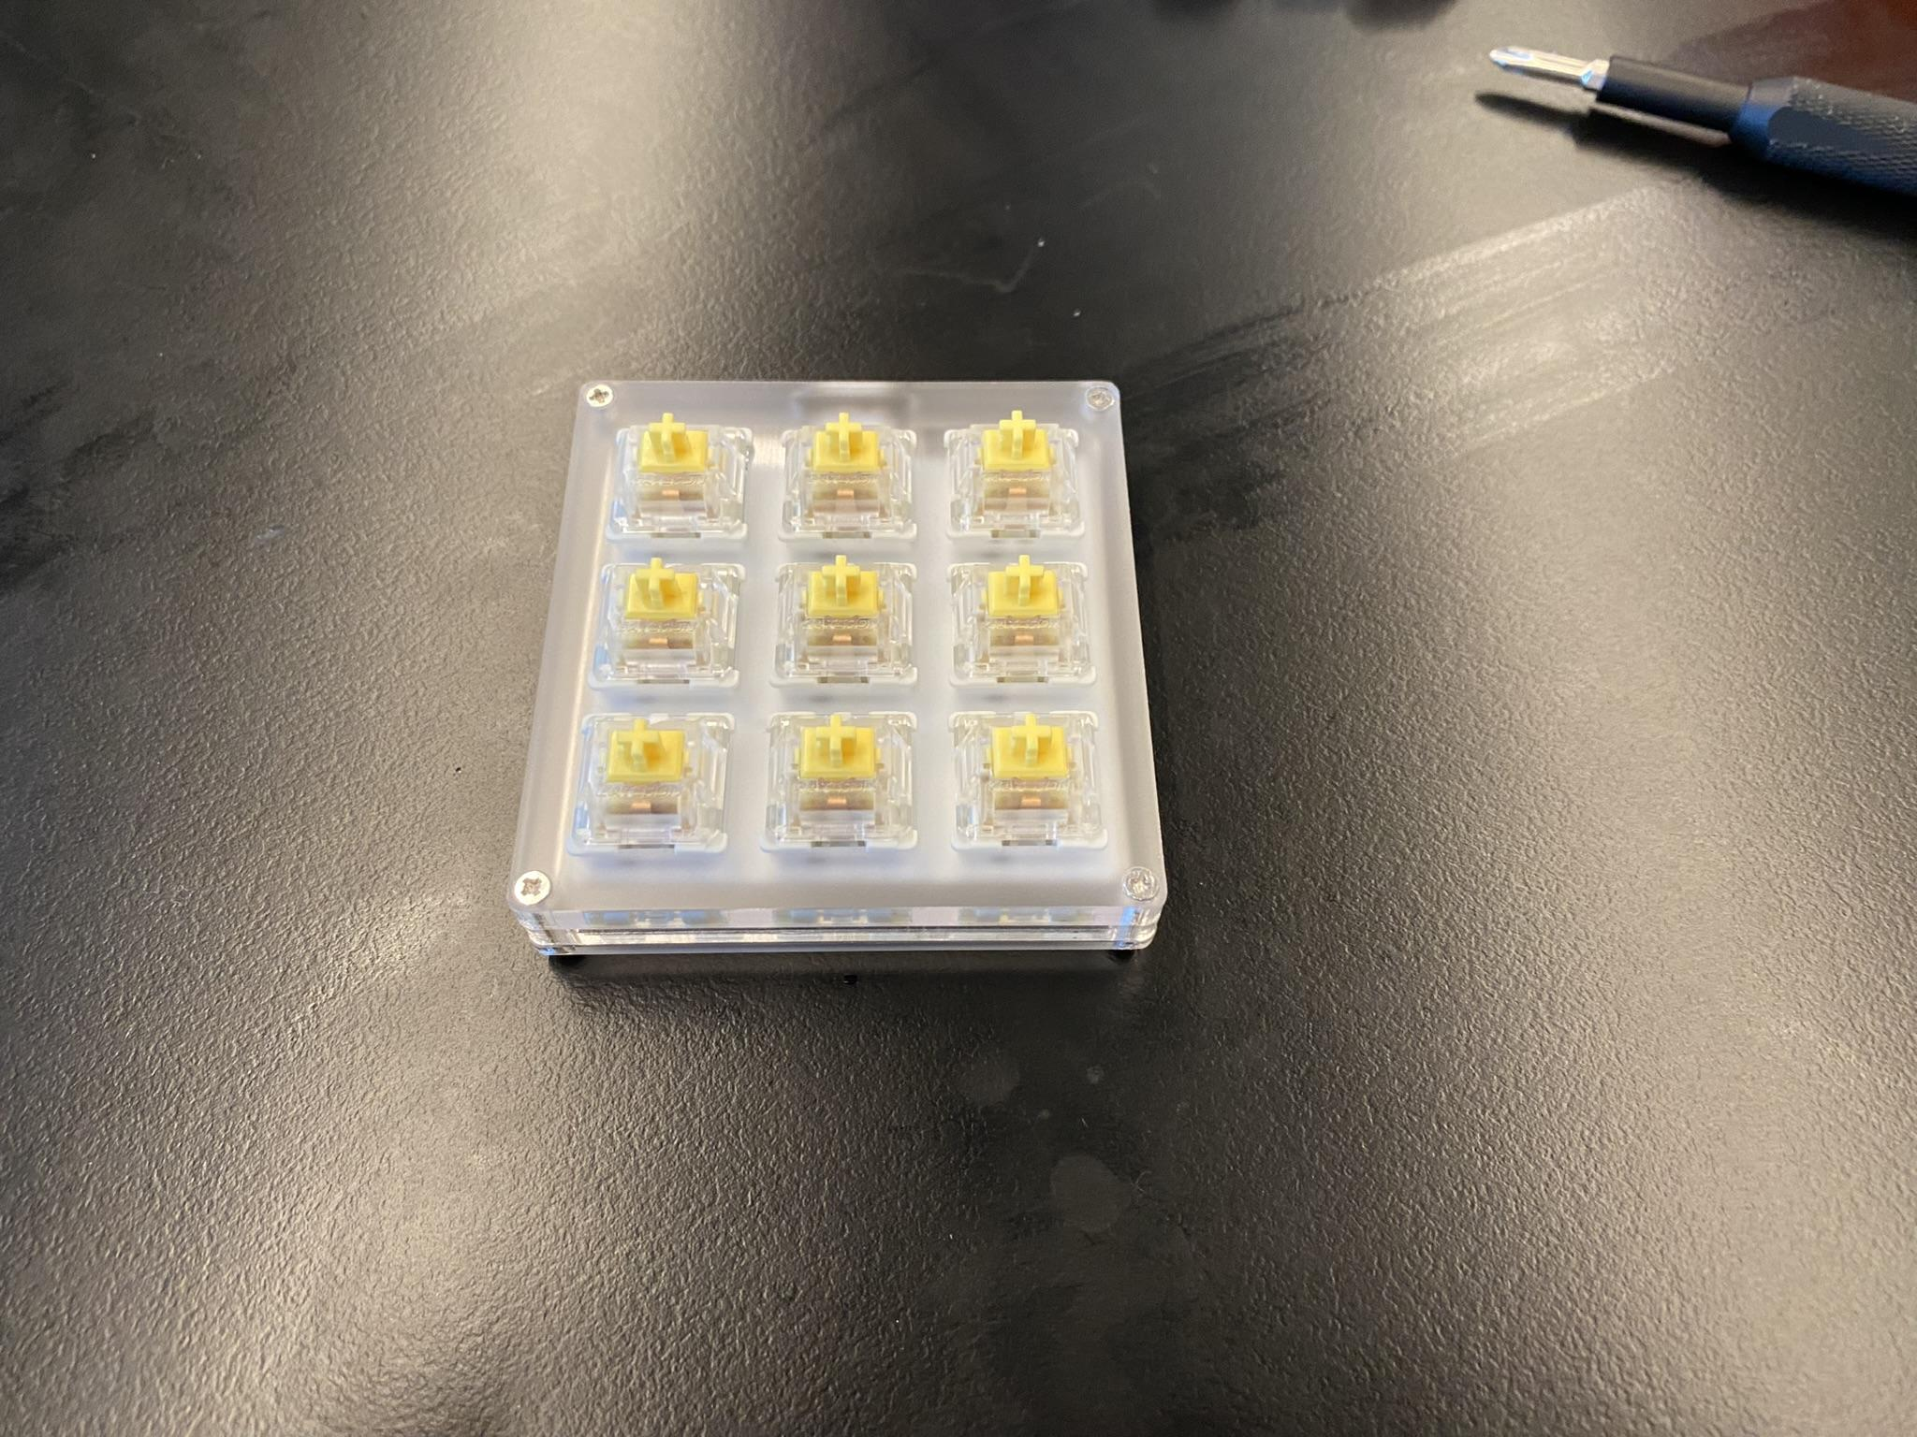

Slide 17
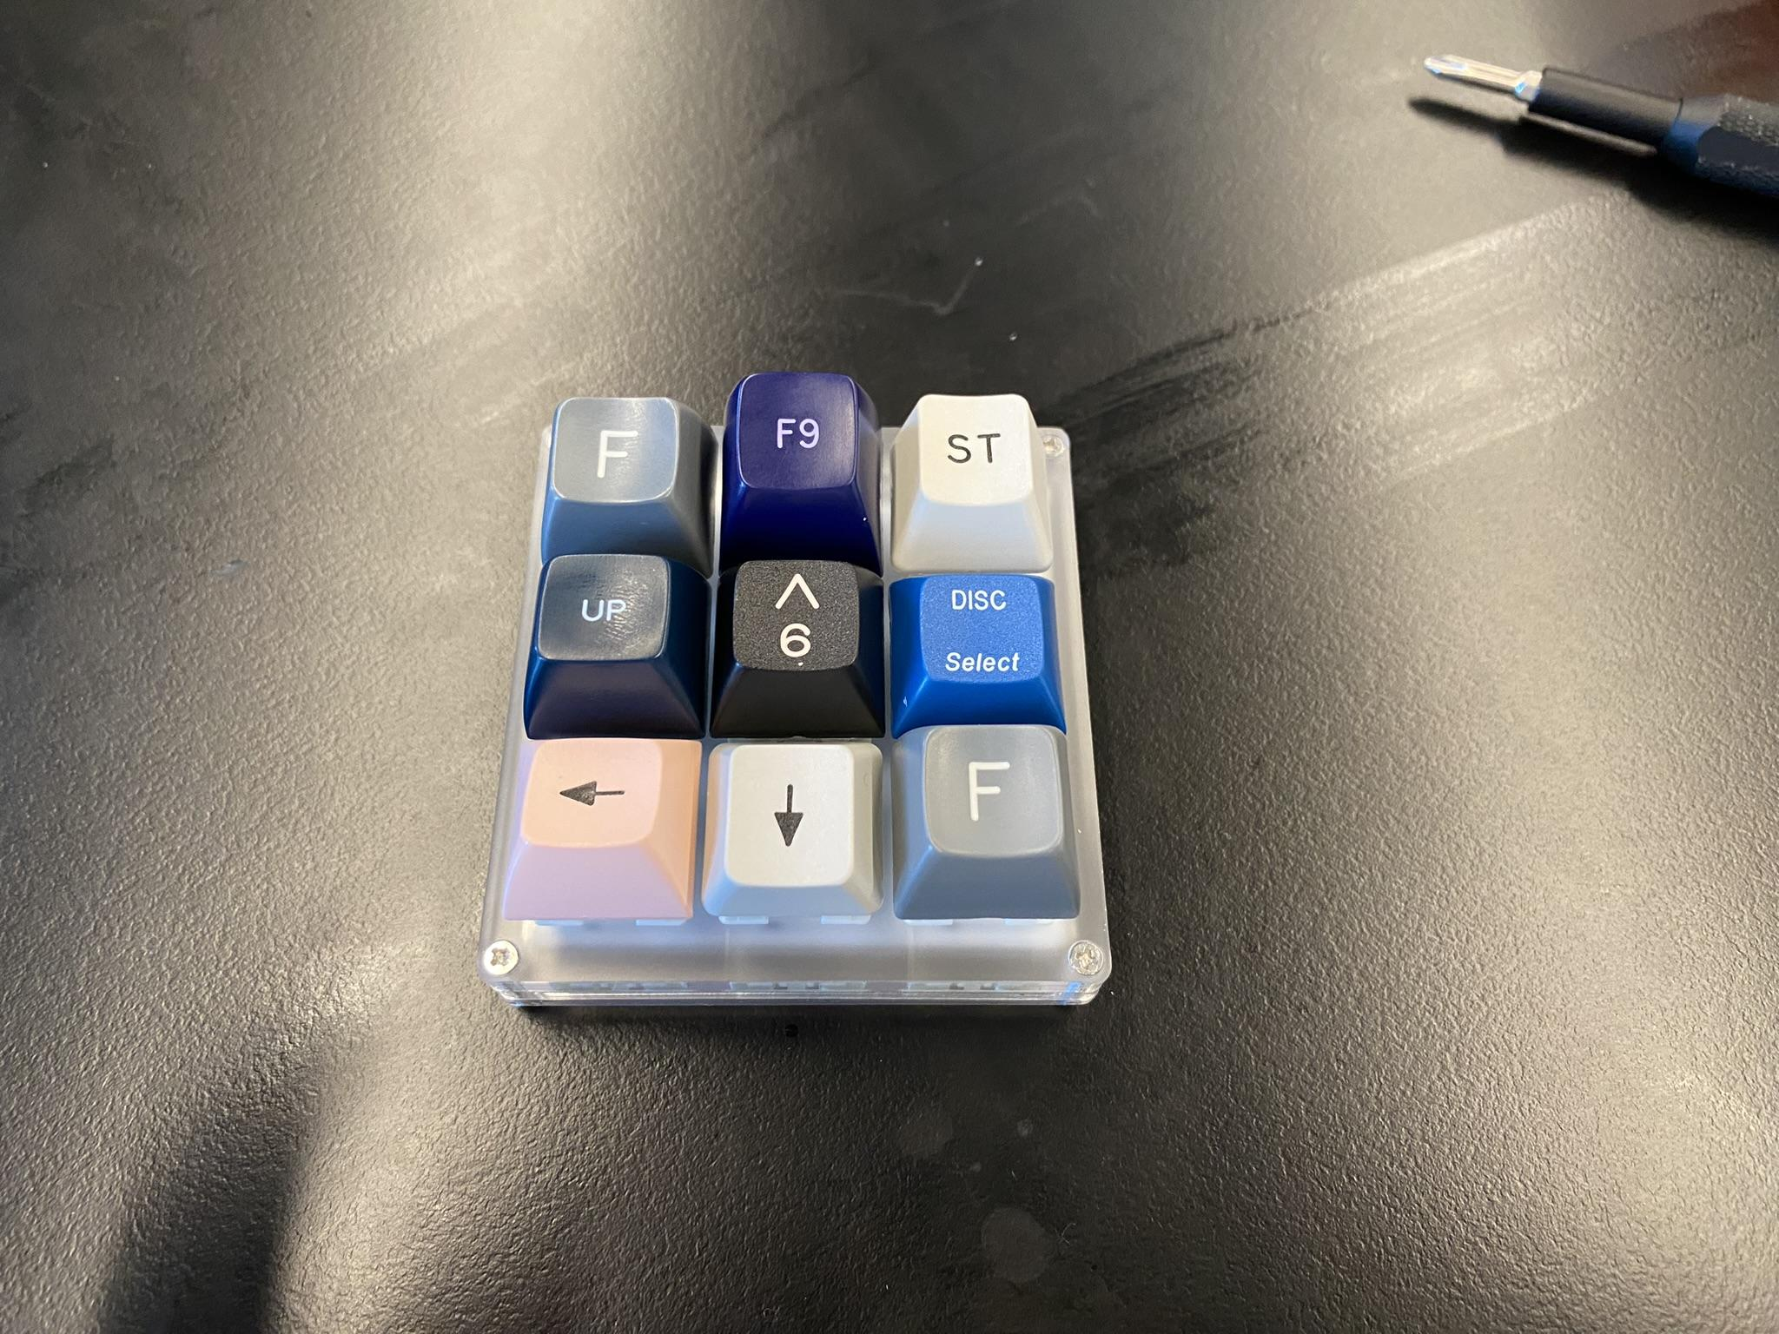

Slide 18
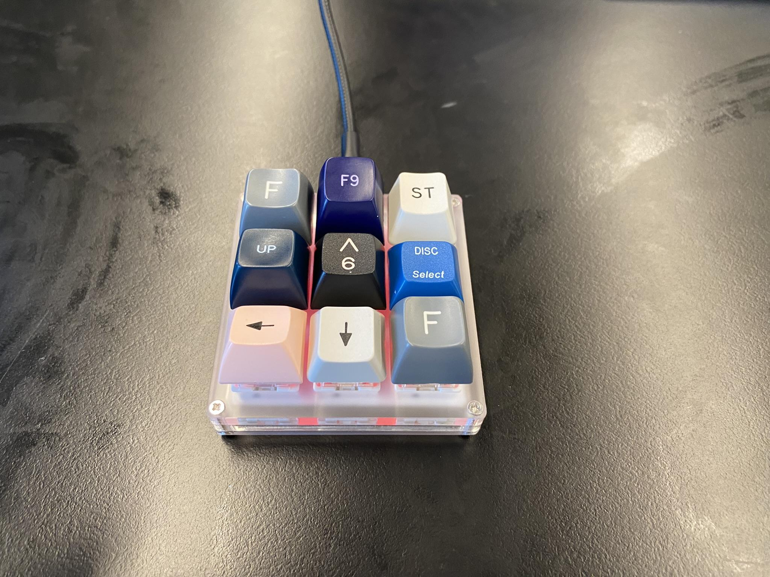

Slide 19
BUT HOW DO YOU PROGRAM AND TEST??
You use VIA!
https://www.caniusevia.com/ (If your browser does not support this see below)
https://github.com/the-via/releases
This will allow you to
1. Test your macropad and ensure the keys were entered correctly and
2. Actually program it once its complete!

Slide 20
THANKS FOR COMING!
If you’re into keyboards feel free to stay and chat we at BUILDS have an unhealthy obsession with keyboards!

